Slide 1
XIII International Aerosol Conference IAC2030 - Mexico City
1
Luis A. Ladino, Graciela B. Raga, and Leah Williams
(on-behalf of the organizing committee)
IARA Board Meeting, Athens, 07 September 2022

Slide 2
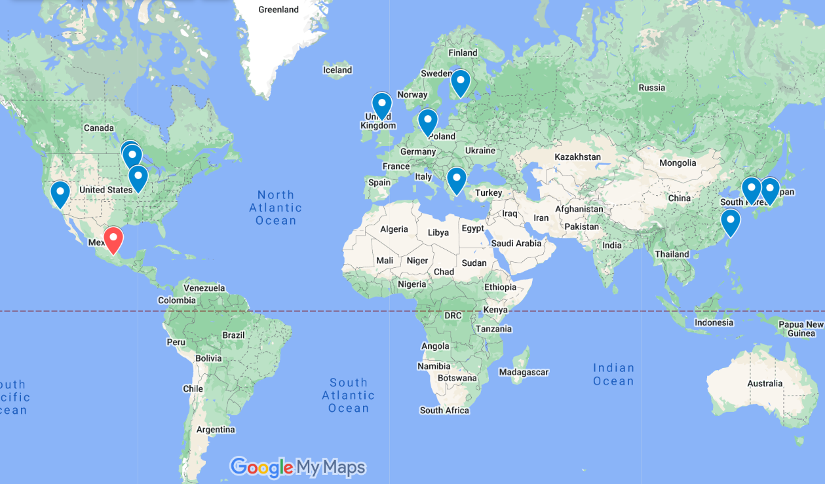
Past cities hosting the IAC
2
An opportunity to broaden IAC geographic horizon

Slide 3
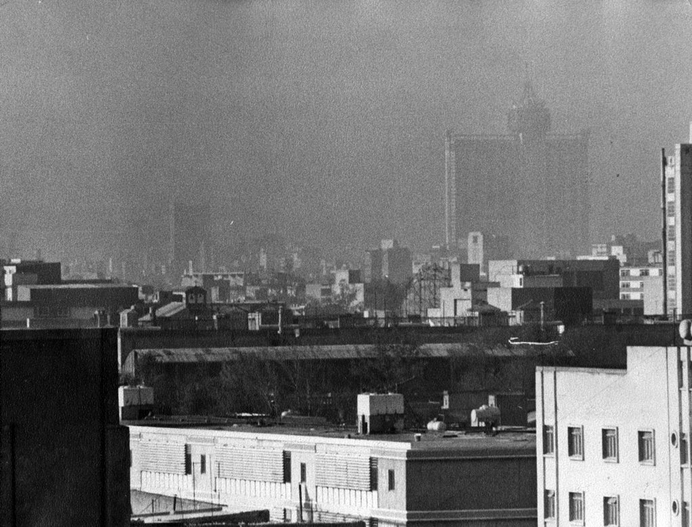
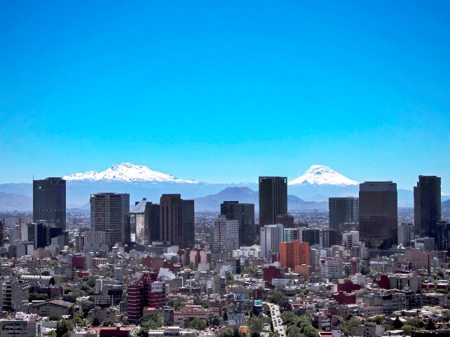
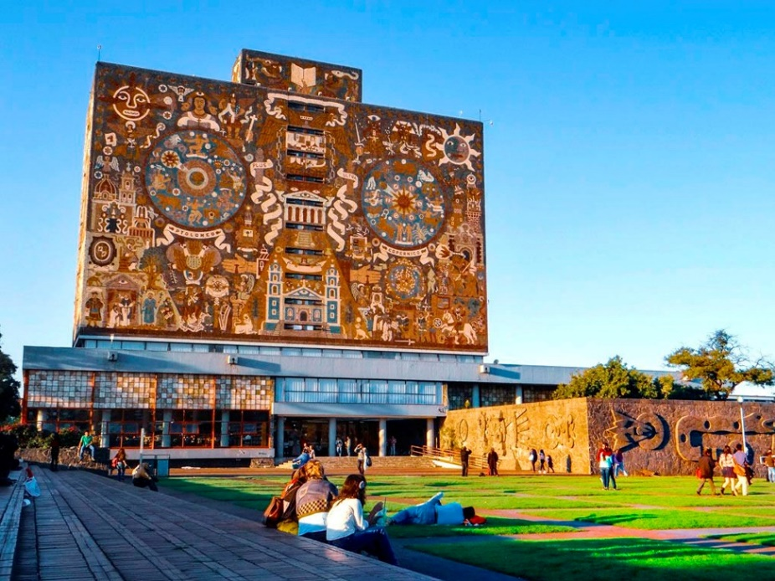
Why Mexico City?
3
Mexico City 1989 (El Universal)
Once one of the world’s most polluted cities in the 80’s, with extreme episodes leading to mass-death of birds, associated with lead, cadmium, and asbestos in particles.
Decades of air quality measurements, aerosol studies, and mitigation actions have led to much improved air quality!!
Mexico City 2022 (https://www.gob.mx/)
DGCS-UNAM
UNAM is one of the largest universities in Latin America and a UNESCO world heritage site, with its famous murals in the central campus.
A leader in air quality and aerosol studies, including health impacts.
Currently, 11 research groups at UNAM in Mexico City and at least 8 other Mexican groups work on the characterization, variability, impacts, and fate of aerosol particles.

Slide 4
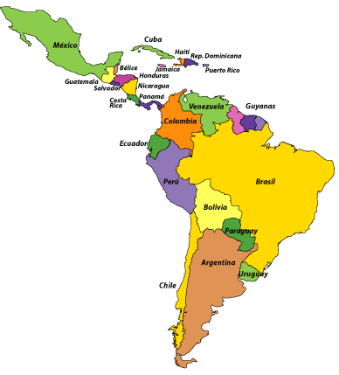
IAC2030 in Mexico City: An opportunity to highlight the diversity and contributions of the aerosol community working in the global south
4
Latin America has a long tradition of hosting international field projects to tackle aerosol questions:
Amazonian aerosols (e.g. LBA)
Megacity aerosols (MILAGRO, PAPILA)
African dust (AMAZE-08 in Brazil; ADABBOY in Mexico, among others)
In situ and satellite-based studies of biomass burning aerosols, volcanic eruptions, black carbon, dust in the Andes, and Patagonian dust.
The aerosol research community in Latin America supports this application:
Brazil (USP and Univ. Federal de Uberlândia),
Chile (Univ. de Chile and CR2),
Bolivia (Univ. Mayor de San Marcos),
Colombia (Univ. Nacional and Univ. de la Salle),
Argentina and Cuba (TBC)
https://www.cerebriti.com/

Slide 5
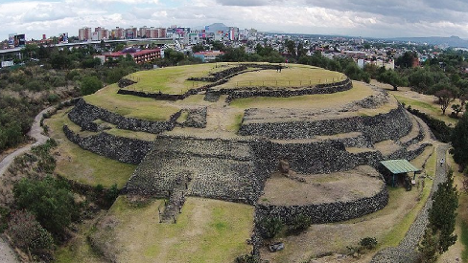
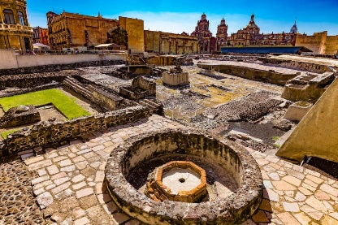
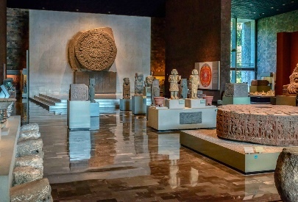
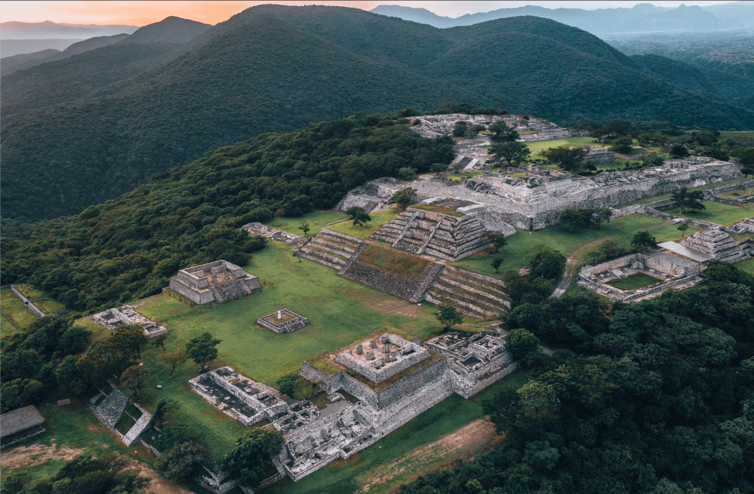
Mexico City: A cultural experience
5
Mexico City grew out of the great metropolis of Tenochtitlan, capital of the Aztec empire and one of the largest cities in the world in the 1500s.
World-class archeological museums and several archeological sites are located within the city and in the surrounding area.
Stunning colonial buildings and churches date from the 1500s and 1600s.
Top restaurants highlighting regional Mexican cuisines, as well as international cuisine.
Art and cultural exhibits.
Large zoo and events for children.
Sporting events.
Cuicuilco Templo Mayor Museum Anthropology Museum
https://www.mexicodesconocido.com.mx/
https://matadornetwork.com/
https://thehappening.com/
Charming “Pueblos Mágicos” (magical towns) are easily accessible (50-150 km) to enjoy a variety of eco-friendly experiences, gastronomic delights, and historical sites.
Teotihuacan Atlantes de Tula Xochicalco
https://www.unionguanajuato.mx/
https://discovermoto.com/
https://mxcity.mx/

Slide 6
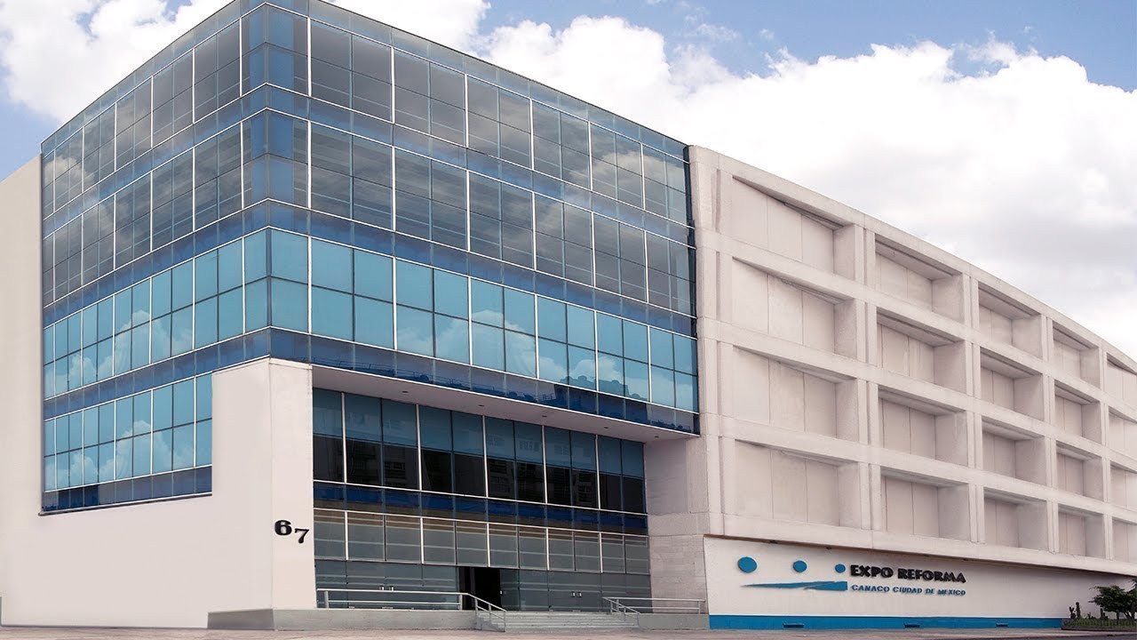
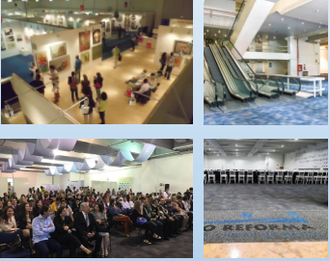
6
Expo Reforma is the proposed venue:
Numerous hotels close to the venue, many within walking distance, such as Barceló México Reforma, Hilton Mexico City Reforma, and Hyatt Regency Mexico City.
Located downtown, only one block from the most emblematic avenue in the city: “Paseo de la Reforma.”
Subway station is three blocks from the venue.
An area of 6500 m² is distributed on 6 levels for exhibits and 2500 m² for meeting rooms. One large room for plenary talks (Xaman Ek: capacity 1800) and 7 rooms for parallel sessions:
Pochteca (cap. 800)
Yacatecutli (cap. 600)
Hermes (cap. 600)
Mercurio (cap. 600)
Alfa (cap. 100)
Uso Multiples 1 (cap. 180)
Uso Multiples 2 (cap. 120)
Exhibits, posters, and coffee break areas in close vicinity

Slide 7
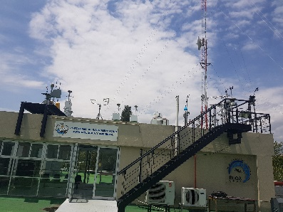
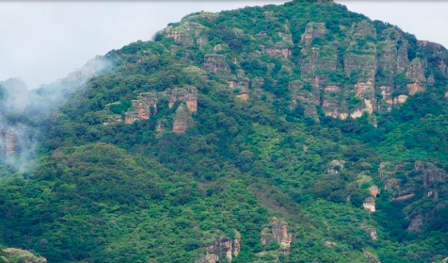
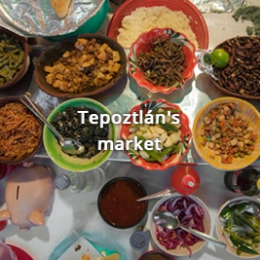
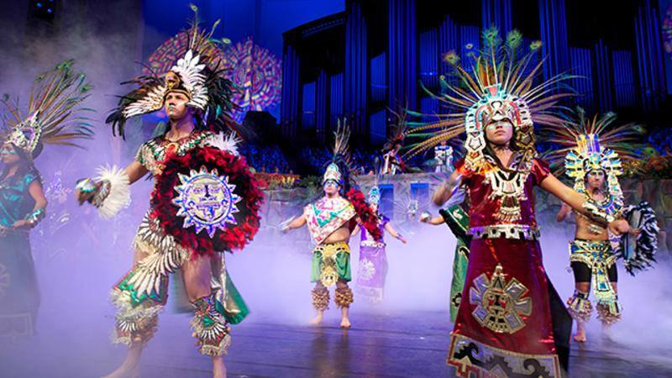
Highlights of the Conference
7
IAC 2030 in Mexico City will be organized by the UNAM with participation of several Latin American Universities.
At least one session will be organized to highlight research studies performed in Latin America.
Tours will be organized to showcase the local academic infrastructure, such as the high-altitude research station at Altzomoni (~4100 m asl) and labs at UNAM.
RUOA
Tours to nearby “magical towns” will highlight authentic Mexican culture.
A multi-cultural event will allow attendees to experience various Mexican traditions.
https://www.visitmexico.com/en/morelos/tepoztlan
http://arqueologiavivademexico.blogspot.com/

Slide 8
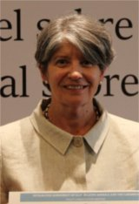
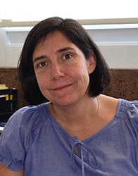
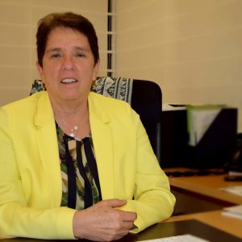
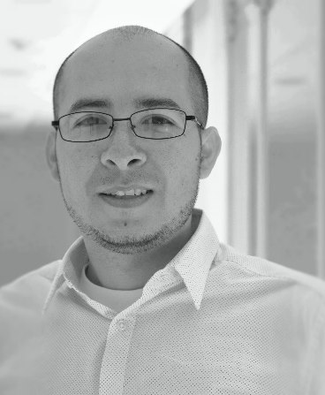
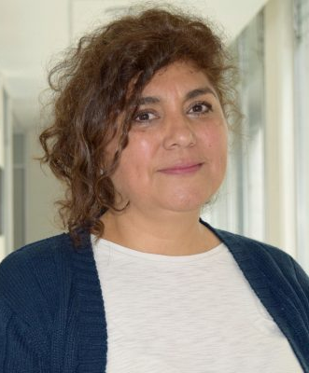
Suggested Committee Personnel
8
Member of the organizing committee of the 3rd Atmospheric Ice Nucleation Conference hosted in Boston (USA) in 2020.
Member of the Advisory board of the International Conference of Nucleation and Atmospheric Aerosols (ICNAA) to be celebrated in Brisbane (Australia) 2023.
Graciela B. Raga
(Conference Chair)
Dara Salcedo
(Conference
Co-chair)
Conference chair of the 16th International Commission on Clouds and Precipitation (ICCP) conference, hosted in 2008 in Cancun (Mexico).
Chief-Editor of Atmósfera, an international peer-reviewed journal published since 1988.
Telma Castro
(Technical Chair)
Luis A. Ladino
(Technical Co-chair)
Elizabeth Vega
(Exhibits and sponsor interaction)
Harry Alvarez (Local tours and student program)
Latin American colleagues will participate in the local and technical committees: Paulo Artaxo, Fatima Andrade, and Samara Carbone (Brazil), Nestor Rojas and Jorge Pachón (Colombia), Laura Gallardo and Nicolas Huneeus (Chile), and Marcos Andrade (Bolivia).

Slide 9
Sponsorship
9
Although the IAC will take place 8 years from now, the head of the Scientific Research Office at UNAM has agreed to commit at least $10,000 USD.
If Mexico City is selected to host the IAC 2030, the organizing committee will work hard to find additional funding from different potential donors such as:
The National Institute of Ecology and Climate Change (INECC)
Petroleos Mexicanos (PEMEX)
The Office of the Mayor of Mexico City
The Ministry of the Environment
Private companies

Slide 10
Summary
10
Mexico City is an excellent location to host the IAC 2030. It provides a great opportunity for the IARA to diversify geographically, to promote more North-South collaborations in the Americas, and to help the growing aerosol community in Latin America. Mexico City will offer IAC participants the chance to experience its long history, rich culture, and famous cuisine.
The proposed venue is centrally located, with hotels, restaurants, and attractions within walking distance. It is close to the financial center and embassies, so this part of the city is safe, lively, and vibrant.
Attendees of IAC 2030 in Mexico City will enjoy the charm, warmth, friendliness, and joie-de-vivre of Mexicans and Latin Americans.
Our team looks forward to hosting the conference and welcoming the aerosol science community in 2030!!

Slide 11
¡Thank you for your Attention!
32
11
raga.graciela@gmail.com , raga@unam.mx
dara.salcedo@ciencias.unam.mx
luis.ladino@atmosfera.unam.mx

